Slide 1
Binary search
ANALYSIS AND DESIGN OF ALGORITHM
UNIT - 3
Prepared By : Kashyap Dave

Slide 2
Binary search
A Binary search algorithm finds the position of a specified input value (the search "key") within a sorted array . For binary search, the array should be arranged in ascending or descending order.

Slide 3
ALGORITHM (Recursive)
recursivebinarysearch(int A[], int first, int last, int key)
if last<first
index=-1
else
int mid = (first + last) / 2
if key=A[mid]
index=mid
else if key<A[mid]
index= recursivebinarysearch(A, first, mid – 1, key)
else
index= recursivebinarysearch(A, mid + 1, last, key)
return index

Slide 4
Algorithm
Algorithm is quite simple. It can be done either recursively or iteratively:
Get the middle element;
If the middle element equals to the searched value, the algorithm stops;
Otherwise, two cases are possible:
Searched value is less, than the middle element. In this case, go to the step 1 for the part of the array, before middle element.
Searched value is greater, than the middle element. In this case, go
to the step 1 for the part of the array, after middle element.
Now, The iterations should stop when searched element is found & when sub array has no elements. In this case, we can conclude, that searched value is not present in the array.

Slide 5
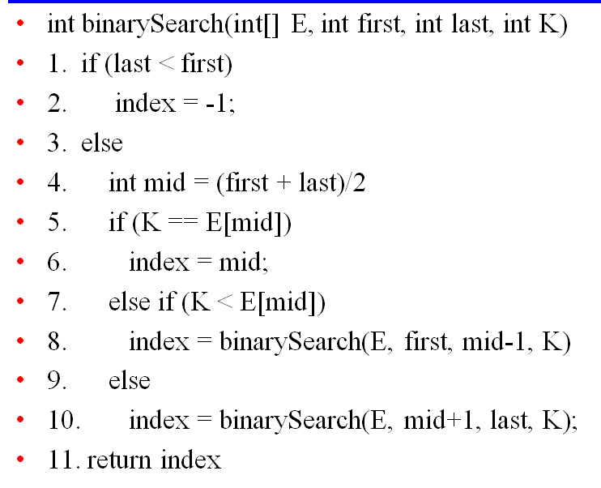
Pseudo code

Slide 6
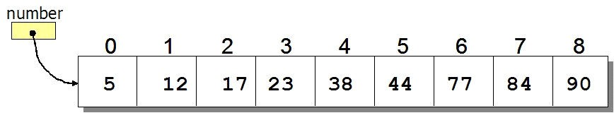
Example

Slide 7
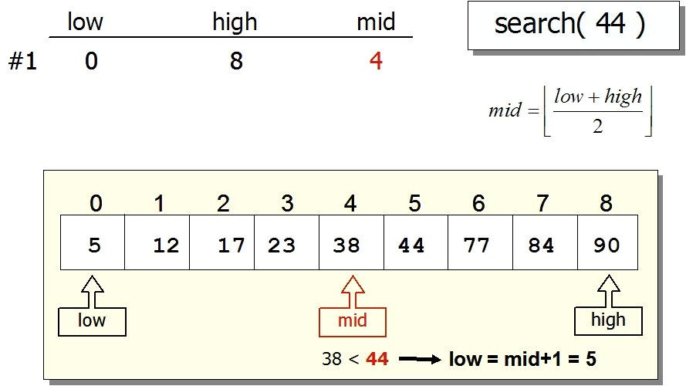
Cont..
Step : 1

Slide 8
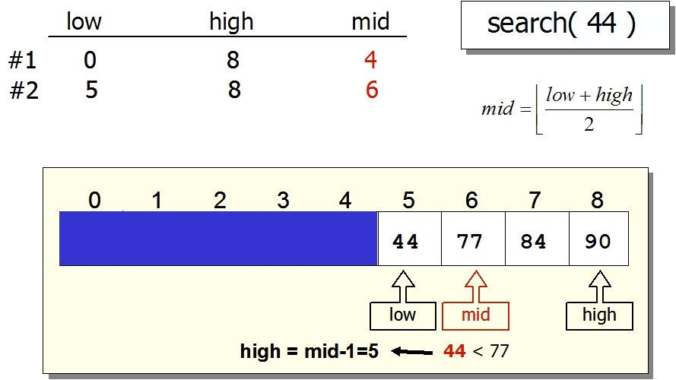
Cont..
Step : 2

Slide 9
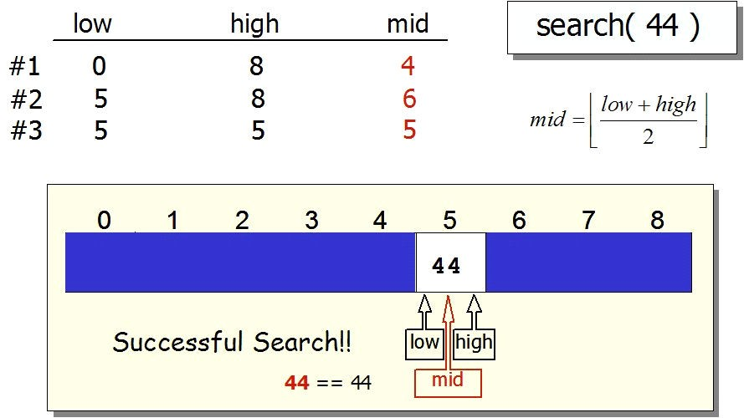
Cont..
Step : 3

Slide 10
Analysis
To analyze the binary search algorithm, we need to recall that each comparison eliminates about half of the remaining items from consideration. If we start with n items, about n/2 items will be left after the first comparison. After the second comparison, there will be about n/4. Then n/8, n/16, and so on.
When we split the list enough times, we end up with a list that has just one item. Either that is the item we are looking for or it is not. Either way, we are done. The number of comparisons necessary to get to this point is i where n/2^i=1. Solving for i gives us i=(log n).
The maximum number of comparisons is log n. Therefore, the complexity of binary search is O(log n).

Slide 11

Thank you

